Slide 1

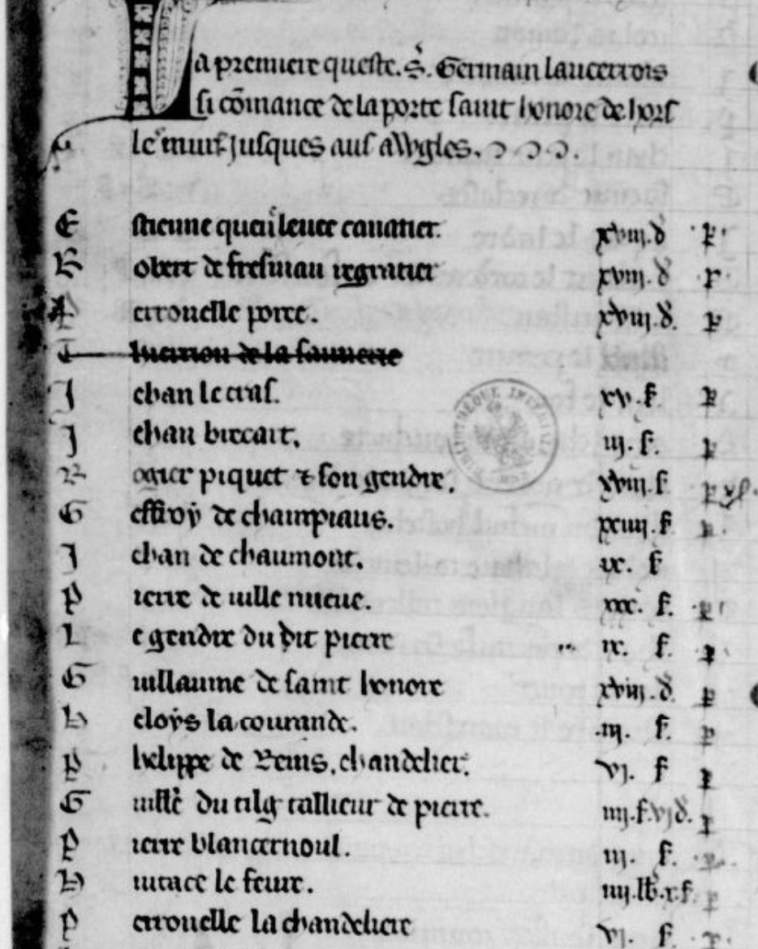
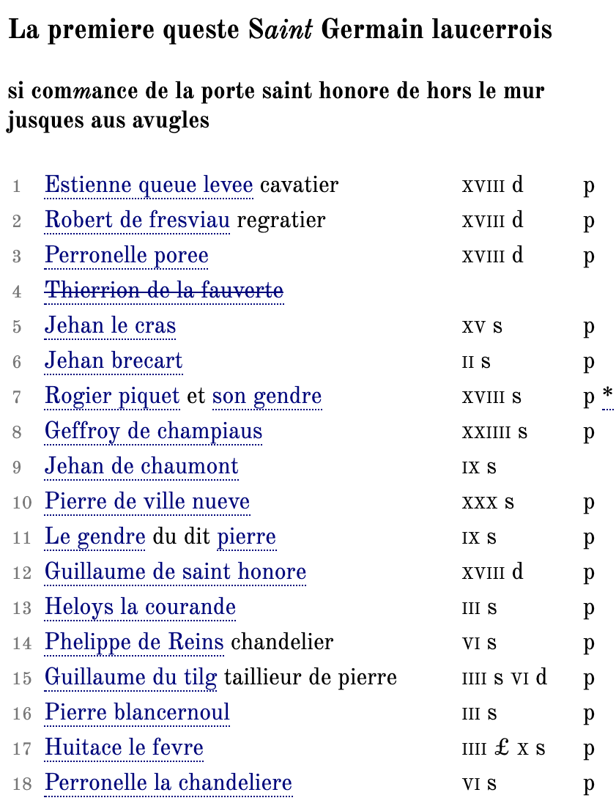
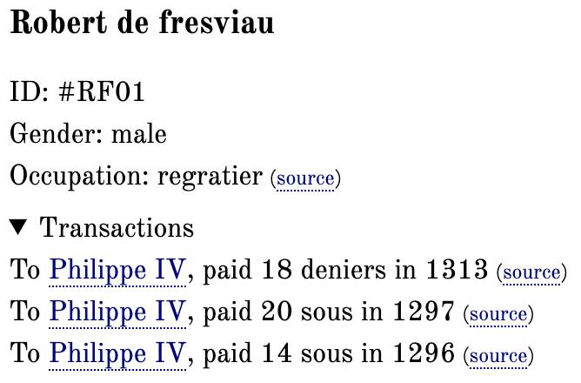
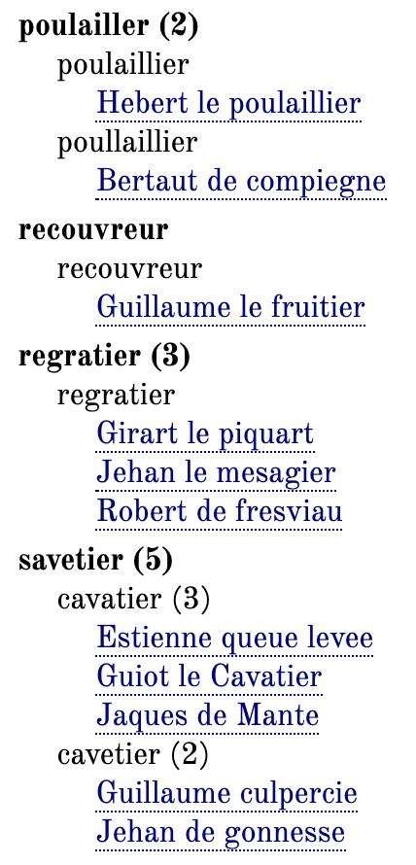

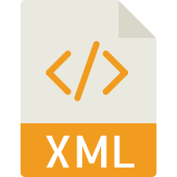




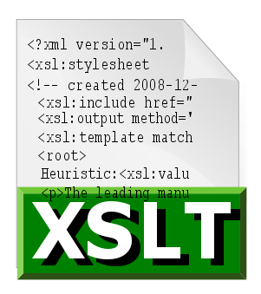
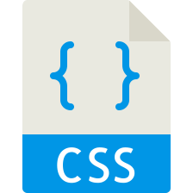











From Document to Data:
Prosopography and Topography in the Tax Rolls of Medieval Paris
Nathan A. Daniels
INTRODUCTION
A TEI-based Digital Edition of the tax rolls levied by King Philip IV on the city of Paris between 1292-1313
Data includes:
People; Occupations; Names; Taxes (financial); Relationships (familial, personal, occupational);
Geography & Topography (streets, landmarks, buildings; cities, regions, countries); Institutions
Preserve text of manuscripts, but extract data for tabulating, mapping, exporting, and Linked Open Data
QUESTION
How do we get from document to data?
TRANSACTION MARKUP
Bookkeeping Ontology by Digital Edition Publishing Cooperative for Historical Accounts (DEPCHA) (bit.ly/30Wr9bd)
Uses @ana to provide markup for RDF
<rs ana="#bk:to">Le roi de France</rs>
<date ana="#bk:when">1313</date>
…
<item ana="#bk:entry">
<persName ana="#bk:from">
Perronelle poree</persName>
<measure ana="#bk:money" quantity="2"
unit="sous">ii.s.</measure>
<seg ana="#bk:status">p.</seg>
</item>
Result: From Perronelle poree to Philip IV,
paid 2 sous in 1313
Manuscript
Digital Edition
Personography
TRANSCRIPTION & MARKUP
Semi-Diplomatic transcription notes and marks up abbreviations, additions & erasures, and marginalia
But focus is on historical data (esp. named entities)
People / places all have unique XML Identifiers
References are disambiguated by these IDs
e.g. “are these two Jehans the same person?”
Occupations, offices, names, goods, payments, etc. are normalized in the metadata for extraction and analysis
Example:
Bertaut de compiegne poullaillier ii.s.vi.d p.
<item>
<persName ref="#BC01">
<forename>Bertaut</forename>
<nameLink>de</nameLink>
<surname>compiegne</surname>
</persName>
<roleName ref="#BC01" role="poulailler"
type="occupation">poullaillier</roleName>.
<measureGrp>
<measure quantity="2" unit="sous">ii.s.
</measure>
<measure quantity="6" unit="deniers">vi.d
</measure>
</measureGrp>
<seg type="status">p.</seg>
</item>
Occupation Index
FUNCTION & SUSTAINABILITY
Better to use flat files or databases?
Open source or proprietary software?
Complex relational databases and Content Management Systems (CMS) can provide additional functionality for searching, exporting, Linked Open Data, and API Management. Proprietary software packages can also be easier to use.
BUT…
They often require dedicated developers to set up, and need significant maintenance over the long term (updates, security, etc). Open file formats are more likely to last and keep working.
Currently using: XML/TEI; XSLT; HTML/CSS;
JavaScript/jQuery; JSON/GeoJSON
WORKFLOW
Manuscript/Avatar
HTML Digital Editions
taxroll.html
TEI Personography
personography.xml
Transcription
taxroll.txt
GeoData
streets.json
TEI Transactionography
transactions.xml
TEI Edition
taxroll.xml
XML Gazetteer
gazetteer.xml
CSV Financial Data
transactions.csv
Linked Open Data
Web Maps
HTML Personography
personography.html
taxrolls.github.io
nathan.daniels@jhu.edu
@nathanadaniels

